Slide 1

Team Name : Fab4Coco
Team Leader Name : Dhanushree Soni
Team Size : 4
Problem Statement : Supply Chain Ontology & Governed Conversational Analytics

Slide 2
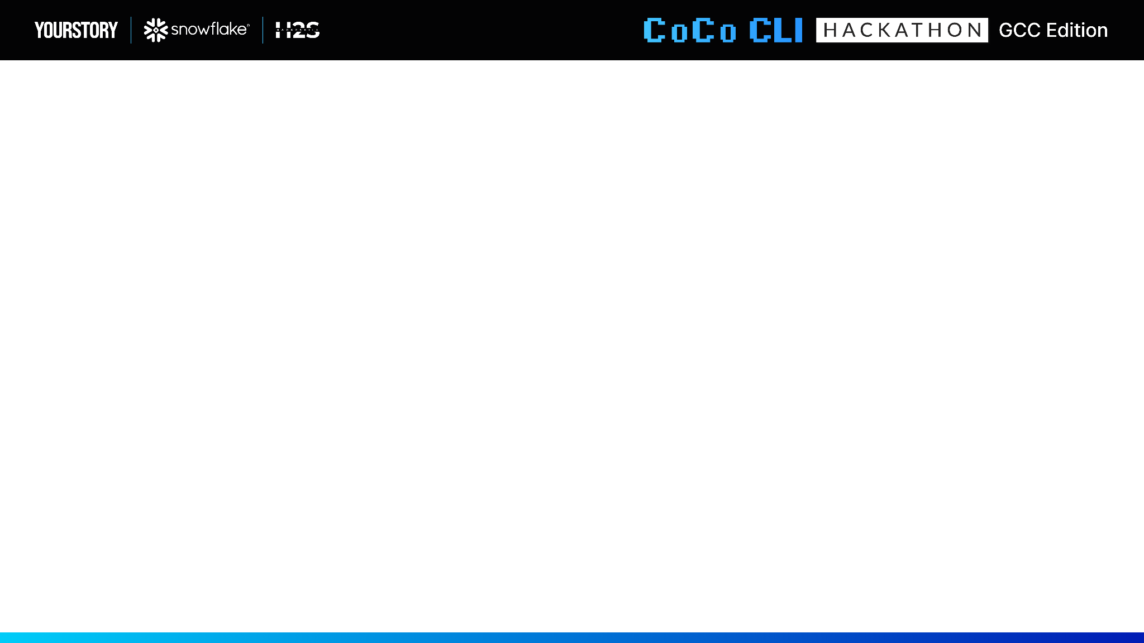
Submission Guidelines:
(Things to add on the submission deck)
1. Problem Brief
What real business problem does this solve?
Who is the target user/persona?
What is the current pain point and how does this improve it?
Industry/domain context
2. Architecture Diagram
System design showing data flow
Which CoCo CLI skills are used and how they connect
Data sources (structured/unstructured)
How modular components plug together
3. Impact Statement
Measurable outcomes (time saved, accuracy improvement, etc.)
Scalability potential
How this extends beyond the demo

Slide 3
Problem Brief
What real business problem does this solve?
In supply chain, "What's our on-time delivery rate?" gets four different answers depending on who you ask. Procurement, Logistics, Finance and Sales each compute OTD, Fill Rate, Days of Inventory and Landed Cost differently — there is no single source of truth. Every question becomes an analyst ticket and a bespoke SQL query, so insight lags the decision.
Who is the target user/persona?
Supply-chain business users (planners, procurement, logistics, finance) who need answers without writing SQL
Data & analytics teams who must guarantee one governed, auditable definition per metric
Current pain point → how this improves it
❌ Today: inconsistent numbers, slow analyst-dependent reporting, no lineage or data-quality guarantee, not self-serve
✅ With our solution: one governed ontology, one sanctioned definition per metric, natural-language self-serve answers — with the generated SQL and the definition attached to every result
Industry/domain context
Supply chain / manufacturing analytics. Built on a canonical model:
Supplier → Part → Plant → Shipment → Order → Customer,
with embedded real-world scenarios (supplier disruption, demand shock, port congestion, ESG events).

Slide 4
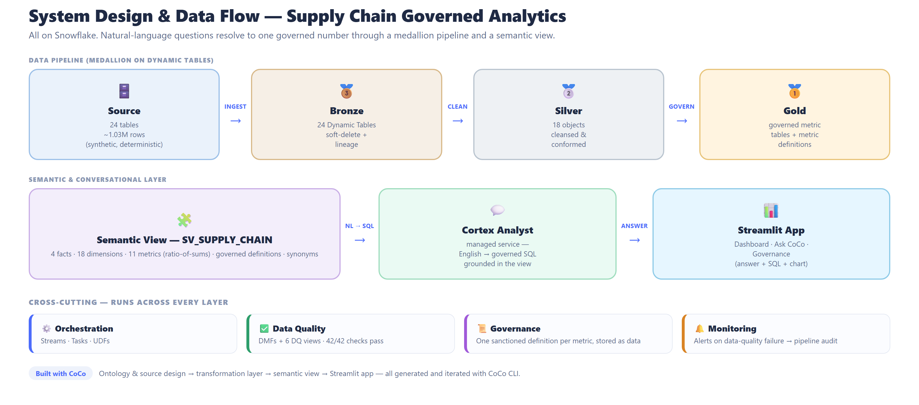

Slide 5
Architecture & CoCo CLI Usage
System design / data flow
Source (24 tables, 1.03M rows)
Bronze (24 Dynamic Tables)
Silver (18 objects — cleansed & conformed)
Gold (governed metric tables)
Semantic View SV_SUPPLY_CHAIN (4 facts · 18 dimensions · 11 metrics · synonyms)
Cortex Analyst (natural language → governed SQL, managed service)
Streamlit App (Dashboard · Ask CoCo · Governance)
Cross-cutting: Streams + Tasks + UDFs (orchestration) · DMFs + 6 DQ views (data quality) · Alerts (monitoring) · Metric definitions stored as data (governance)
How CoCo CLI was used (end to end, all 4 phases)
Ontology & source design — CoCo analyzed Marketplace datasets, defined entities/relationships/governed metrics and the 24-table canonical source layer
Transformation layer — CoCo generated the Bronze→Silver→Gold Dynamic Tables, UDFs, streams, tasks, data-quality checks
Semantic view — CoCo built SV_SUPPLY_CHAIN with governed definitions as metric descriptions + synonyms
Streamlit app — CoCo generated the 3-tab Cortex Analyst app and iteratively fixed every runtime issue to a working deploy
Data sources
Structured synthetic supply-chain data (deterministic, hash-seeded — fully reproducible), designed from Snowflake Marketplace dataset analysis.
Modular components
Each layer plugs into the next through Gold + the semantic view — new metrics, risk/ESG, forecasting, or a Cortex Agent all attach to the same governed foundation with no rework.

Slide 6
Impact & Results
Measurable outcomes
74.26% overall on-time delivery — the same governed number for every persona (cross-persona consistency = the judged differentiator)
42 / 42 data-quality checks pass (100%) across 5 dimensions (business rules, completeness, uniqueness, referential integrity, freshness)
Self-serve in seconds — natural-language question → answer + SQL + chart, replacing the analyst-ticket cycle
Embedded demand-shock scenario surfaced in one question: OTD drops 85% → 47.5% (Oct 2024) → recovers to ~86% by Jan 2025
Scalability potential
Runs entirely on Snowflake — Dynamic Tables auto-refresh, warehouse auto-suspends (cost-efficient)
Deterministic model scales from synthetic to live Marketplace or ERP data with no redesign
How this extends beyond the demo
Extend the semantic view with risk & ESG (sanctions, spend-at-risk, ESG violations)
Demand forecasting via Cortex ML on the clean history series
Business alerts (OTD threshold, stockout risk, supplier-risk escalation)
A Cortex Agent blending governed metrics with unstructured documents

Slide 7
Architecture & CoCo CLI Usage
System design / data flow
Source (24 tables, 1.03M rows)
Bronze (24 Dynamic Tables)
Silver (18 objects — cleansed & conformed)
Gold (governed metric tables)
Semantic View SV_SUPPLY_CHAIN (4 facts · 18 dimensions · 11 metrics · synonyms)
Cortex Analyst (natural language → governed SQL, managed service)
Streamlit App (Dashboard · Ask CoCo · Governance)
Cross-cutting: Streams + Tasks + UDFs (orchestration) · DMFs + 6 DQ views (data quality) · Alerts (monitoring) · Metric definitions stored as data (governance)
How CoCo CLI was used (end to end, all 4 phases)
Ontology & source design — CoCo analyzed Marketplace datasets, defined entities/relationships/governed metrics and the 24-table canonical source layer
Transformation layer — CoCo generated the Bronze→Silver→Gold Dynamic Tables, UDFs, streams, tasks, data-quality checks
Semantic view — CoCo built SV_SUPPLY_CHAIN with governed definitions as metric descriptions + synonyms
Streamlit app — CoCo generated the 3-tab Cortex Analyst app and iteratively fixed every runtime issue to a working deploy
Data sources
Structured synthetic supply-chain data (deterministic, hash-seeded — fully reproducible), designed from Snowflake Marketplace dataset analysis.
Modular components
Each layer plugs into the next through Gold + the semantic view — new metrics, risk/ESG, forecasting, or a Cortex Agent all attach to the same governed foundation with no rework.

Slide 8


